Slide 1
20CSC71-DEEP LEARNING
UNIT-2
Momentum-Based Optimization
S.MOHANA SARANYA
AP/CSE

Slide 2


Slide 3
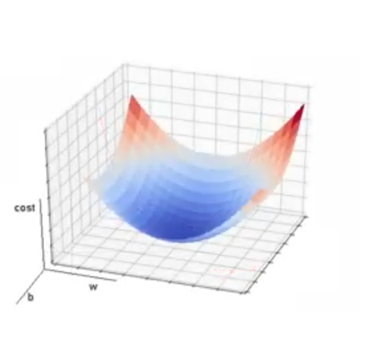
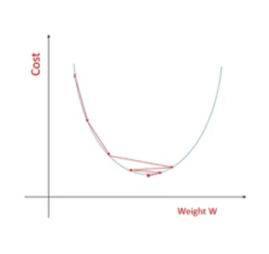

Slide 4
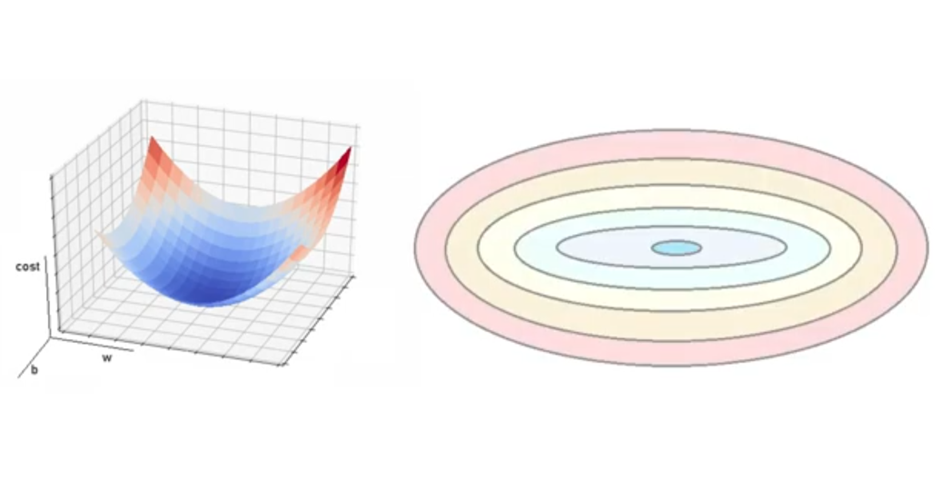

Slide 5
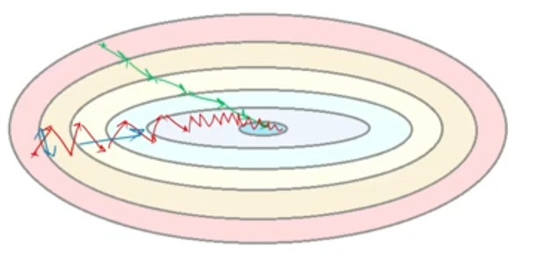

Slide 6
Gradient descent with momentum
It works by adding a fraction of the previous weight update to the current weight update so that the optimization algorithm can build momentum as it descends the loss function
Momentum helps to,
Escape local minima and saddle points
Aids in faster convergence by reducing oscillations
Smooths out weight updates for stability
Reduces model complexity and prevents overfitting
Can be used in combination with other optimization algorithms for improved performance.

Slide 7

Where
v is the momentum term,
m is the momentum hyperparameter (typically set to 0.9),
ε is the learning rate,
g is the gradient of the loss function to the weights.

Slide 8
exponentially weighted decay of past gradients-every update is computed by combining the update in the last iteration with the current gradient.
m determines what fraction of the previous velocity to retain in the new update, and add this “memory” of past gradients to our current gradient.
This approach is commonly referred to as momentum

Slide 9
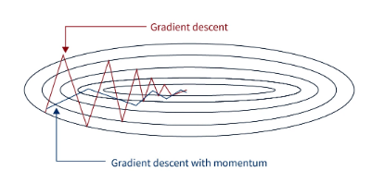
How does Momentum-Based Gradient Descent Work?
Gradient descent with momentum is an optimization algorithm that helps accelerate the convergence of gradient descent by adding a momentum term to the weight update.
The momentum term is based on the previous weight update and helps the algorithm build momentum as it descends the loss function.

Slide 10
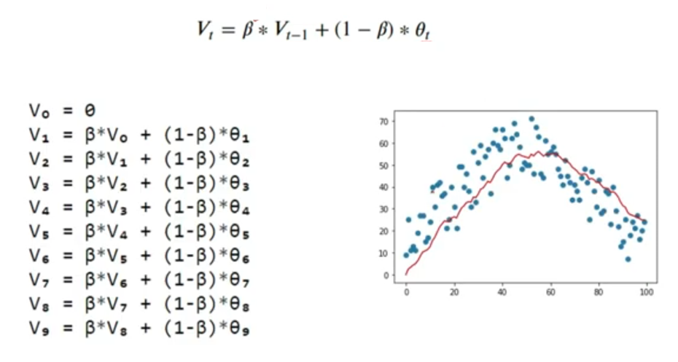

Slide 11
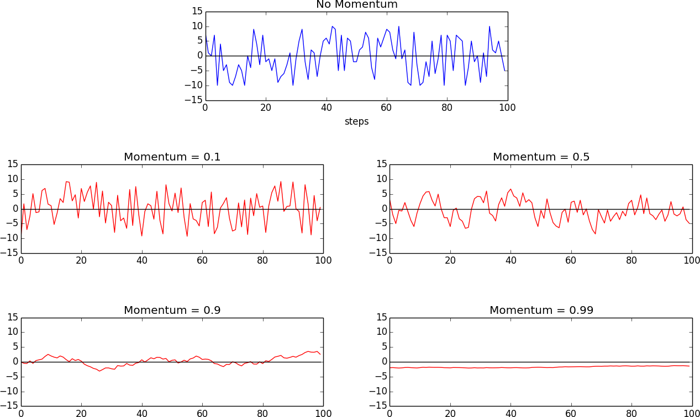

Slide 12
Nesterov Accelerated Gradient (NAG)
computes the gradient on the error surface at θ + V_{i − 1} during the velocity update instead of at θ.
allow Nesterov momentum to change its velocity in a more responsive way

Slide 13
A Brief View of Second-Order Methods
Second-order methods, also known as Newton's methods or Hessian-based methods, are optimization techniques used to find the minimum or maximum of a function
first-order methods (e.g., gradient descent), which only use the first derivative (gradient) of the function, second-order methods also consider the second derivative (Hessian matrix) to guide the optimization process.

Slide 14
Conjugate gradient descent
attempt to improve on a naive method of steepest descent
The key idea steepest descent is to move in the direction opposite to the gradient to descend towards the minimum of the function.
We jump to the minimum and then recompute the gradient to determine the direction of the search.
It turns out that this method ends up zigzagging a significant amount, because each time we move in the direction of steepest descent, we undo a little bit of progress in another direction

Slide 15
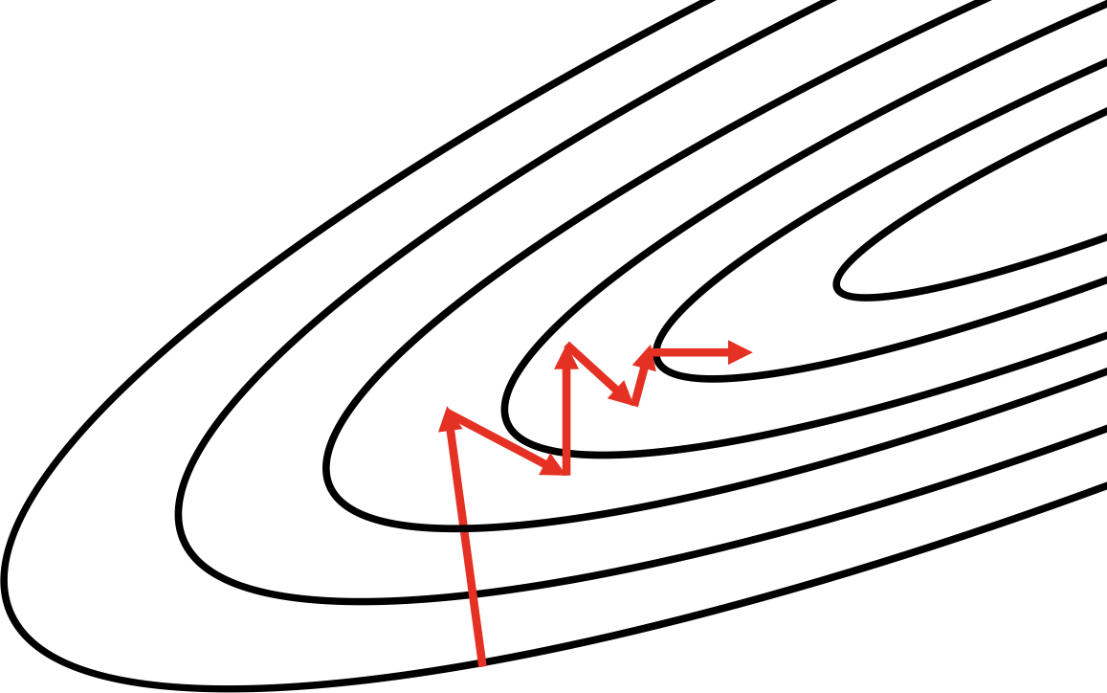
The method of steepest descent often zigzags; conjugate descent attempts to
remedy this issue

Slide 16
conjugate direction relative to the previous choice instead of the direction of steepest descent.
The conjugate direction is chosen by using an indirect approximation of the Hessian to linearly combine the gradient and our previous direction.
With a slight modification, this method generalizes to the nonconvex error surfaces we find in deep networks

Slide 17
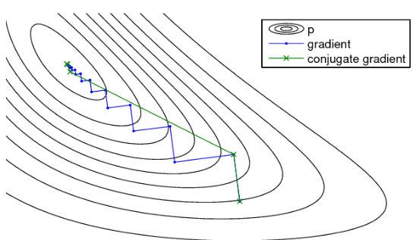

Slide 18
Broyden–Fletcher–Goldfarb–Shanno (BFGS) algorithm
attempts to compute the inverse of the Hessian matrix iteratively and use the inverse Hessian to more effectively optimize the parameter vector
BFGS has a significant memory footprint, but recent work has produced a more memory-efficient version known as L-BFGS
TensorFlow does not currently support either conjugate gradient descent or L-BFGS

Slide 19
Learning Rate Adaptation
another major challenge for training deep networks is appropriately selecting the learning rate
A learning rate that is too small doesn’t learn quickly enough, but a learning rate that is too large may have difficulty converging as we approach a local minimum or region that is ill-conditioned

Slide 20
Three of the most popular adaptive learning rate algorithms
AdaGrad
RMSProp
Adam

Slide 21
The key steps of the AdaGrad algorithm are as follows:
Start with an initial learning rate (usually a small value) and initialize a sum of squared gradients for each parameter to zero.
For each iteration of the training process:
a. Compute the gradient of the loss function with respect to each parameter.
b. Update the sum of squared gradients for each parameter by adding the square of the current gradient.
c. Calculate the learning rate for each parameter as the initial learning rate divided by the square root of the accumulated squared gradients for that parameter.
d. Update the parameter values using the newly calculated learning rates.

Slide 22
AdaGrad—Accumulating Historical Gradients
It adapts the learning rate for each parameter during the training process based on historical information about the gradients of that parameter
The main idea behind AdaGrad is to address the challenges of choosing an appropriate learning rate manually
Traditional gradient descent methods use a fixed learning rate for all parameters, which might lead to slow convergence or even divergence in some cases
AdaGrad tackles this issue by automatically adjusting the learning rate based on the past gradients encountered during training
This learning rate is inversely scaled with respect to the square root of the sum of the squares (root mean square) of all the parameter’s historical gradients

Slide 23
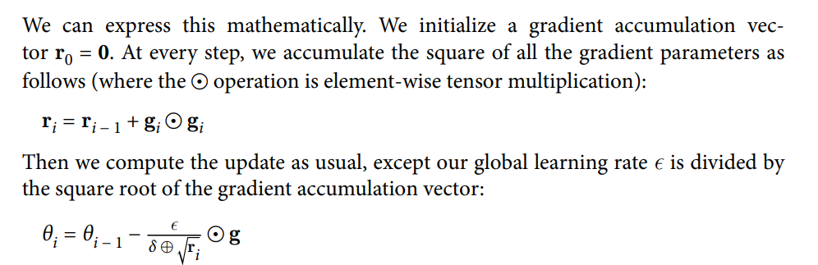
we add a tiny number δ (~10 power −7) to the denominator in order to prevent division by zero.

Slide 24
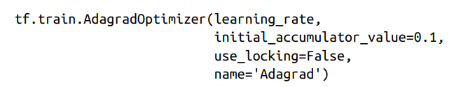
https://keras.io/api/optimizers/adagrad/

Slide 25
RMSProp—Exponentially Weighted Moving Average of Gradients
While AdaGrad works well for simple convex functions, it isn’t designed to navigate the complex error surfaces of deep networks
Flat regions may force AdaGrad to decrease the learning rate before it reaches a minimum
Compared to naive accumulation, exponentially weighted moving averages also enable us to “toss out” measurements that we made a long time

Slide 26
RMSProp stands for Root Mean Square Propagation
The primary motivation behind RMSProp is to balance the accumulation of squared gradients used in AdaGrad
Instead of summing up all past squared gradients, RMSProp applies an exponentially decaying average of squared gradients to update the learning rate adaptively
This helps prevent the learning rate from decreasing too rapidly, allowing the algorithm to converge more effectively and efficiently

Slide 27

The decay factor ρ determines how long we keep old gradients.
The smaller the decay factor, the shorter the effective window.
The adaptive learning rate in RMSProp allows the algorithm to effectively navigate steep and flat regions of the loss function. This makes RMSProp more robust and better suited for various optimization landscapes compared to traditional gradient descent with a fixed learning rate.
https://keras.io/api/optimizers/rmsprop/

Slide 28
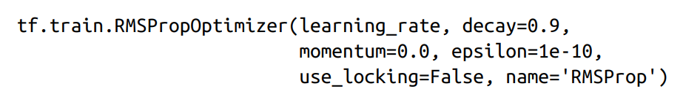

Slide 29
Adam—Combining Momentum and RMSProp
Adaptive Moment Estimation combines the ideas of adaptive learning rates from RMSProp and momentum to improve convergence and training efficiency.
The main features of the Adam optimization algorithm are:
Adaptive Learning Rates: Like RMSProp, Adam adapts the learning rates for each parameter during training. It calculates individual learning rates based on the average of past squared gradients for each parameter. This adaptive learning rate scheme allows for quicker convergence in different directions of the optimization landscape.
Momentum: Adam also incorporates the concept of momentum, which helps to smooth the optimization process and avoid oscillations during training. Momentum enables the algorithm to have inertia, leading to more stable updates of the parameters.

Slide 30


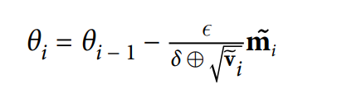
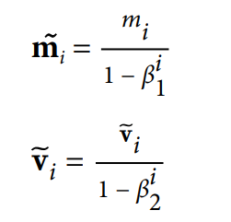
ADAM=Momentum +RMSProp
Momentum
RMSProp
ADAM
Where,

Slide 31
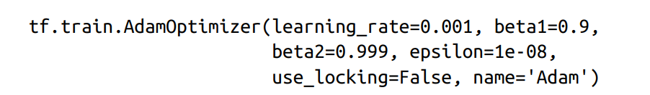
The adaptive learning rate in Adam allows the algorithm to efficiently handle different types of data and optimization landscapes, making it one of the most widely used optimization algorithms for training deep neural networks.
While Adam provides excellent performance in many cases, it is not universally superior to all other optimization algorithms.
Depending on the specific problem and data, other methods such as RMSProp, SGD with momentum, or other adaptive learning rate algorithms might also be suitable choices.
https://keras.io/api/optimizers/adam/

Slide 32
